Slide 1

Web Scraping II

Slide 2
Recap of Web Scraping I
Final 3 Data Frames From Last Lecture Should All Be Saved to CSV’s on PC
FINAL_VIOLENT.CSV
FINAL_ZIP.CSV
FINAL_STATE_ABBREV.CSV
Think About What Other City Information Could Potentially Be a Factor in Violent Crimes
Think About What Other City Information Could Potentially Be Influenced by the Prevalence of Violent Crimes

Slide 3
Supplement Introduction
Step 1: Open Supplement
Step 2: Unzip and Open .Rmd
Step 2: Ensure You Have the Following R Packages Installed
tidyverse
rvest (Requires Internet)
Step 3: Switch Knitter
Step 4: Read the Introduction

Slide 4
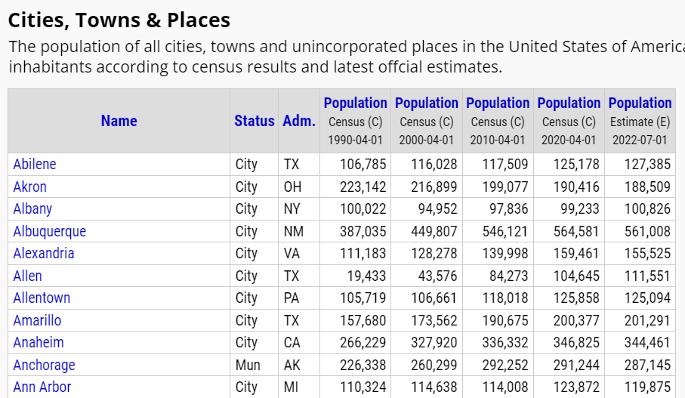
Part 1: Connection to Population Change and Density
Step 1: Select the Link and Observe the Following Table
Step 2: Questions?
What is the Connection to Violent Crimes?
How is this Useful When Related to Violent Crimes?

Slide 5
Part 1: Connection to Population Change and Density
Step 3: Run Chunk 1
What is required to create a Percentage Change variable?
What is required to create a Population Density variable?
Step 4: Run Chunk 2
Step 5: No-Knitter

Slide 6
Part 2: Inclusion of Expert Opinion
Step 1: Selector Gadget Website
Open Source
Chrome Extension Exists
Easy: Drag Link to Bookmark Bar as Webpage Explains
Step 2: Observe the Article on 2018’s Safest and Most Dangerous States
What info could be of use?
Do you agree identification?

Slide 7
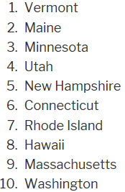
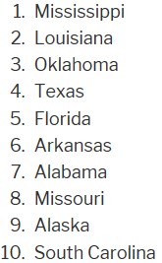
Part 2: Inclusion of Expert Opinion
Step 3: Information of Interest
Safe vs Dangerous
Goal: Scrape this Information into Vectors in R to Create a Table

Slide 8
Part 2: Inclusion of Expert Opinion
Step 4: Identifying CSS Selector
Go to Web Page
Choose SelectorGadget in Bookmark Tab
Locate This Box

Slide 9
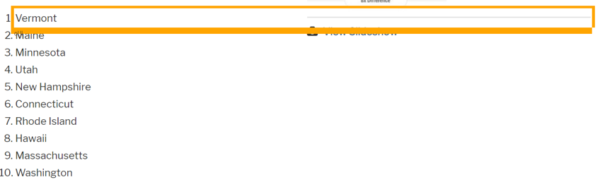
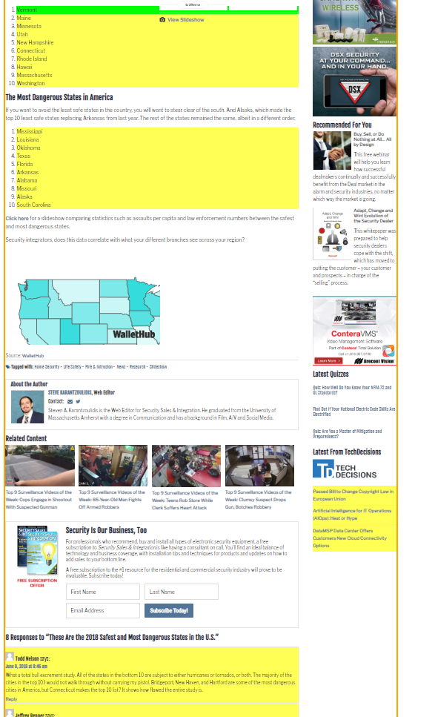
Part 2: Inclusion of Expert Opinion
Step 4: Continued
Find Content You Want
Point and Click
to Select Info
Info We Want is
Highlighted
Info We Don’t
Want, As Well
Hover Over Text We Want

Slide 10
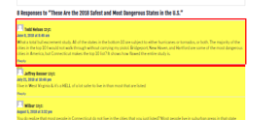
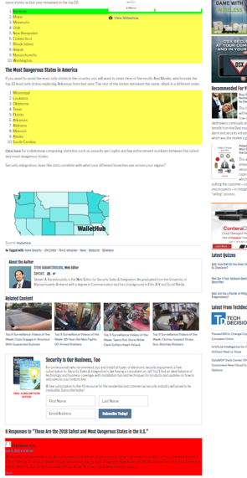
Part 2: Inclusion of Expert Opinion
Step 4: Continued
Find Content You Don’t Want
Point and Click
to Deselect
Locate This Box
Hover Over Text We Don’t Want

Slide 11
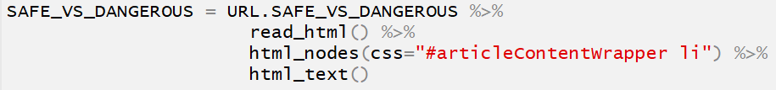
Part 2: Inclusion of Expert Opinion
Step 4: Continued
Locate This Box
Copy CSS Selector
“#articleContentWrapper li”
Step 5: Run Chunk 1
Step 6: Run Chunk 2
What About the Other States?
Step 7: Walk-off Knit

Slide 12
Closing
Disperse and Make Reasonable Decisions

